Slide 1
Pilot scRNA-Seq QC Analysis
2021.07.15 – Nathan T. Johnson

Slide 2
Goal & Datasets
First pass analysis to assess the quality of Pilot scRNA-Seq Data
3 Datasets
10k PMBC (Comparison)
BGI
MIT

Slide 3
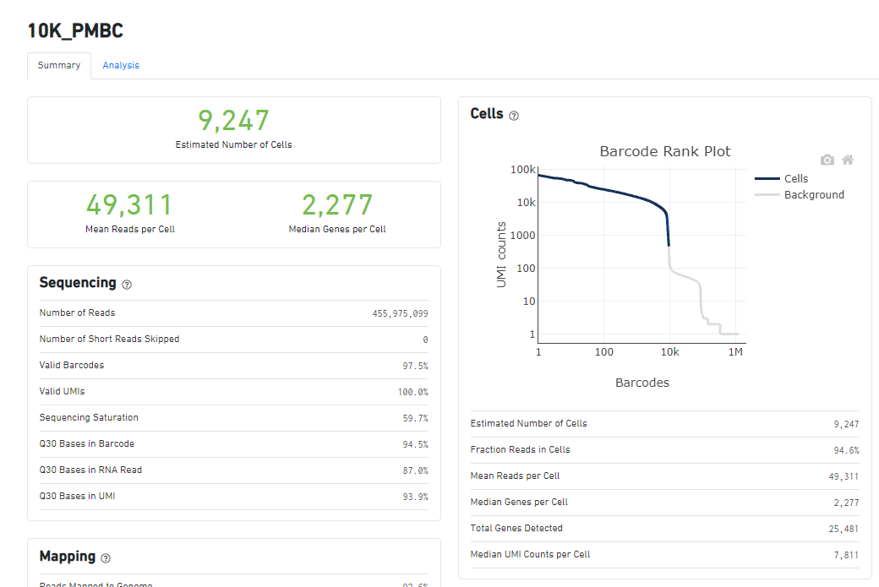
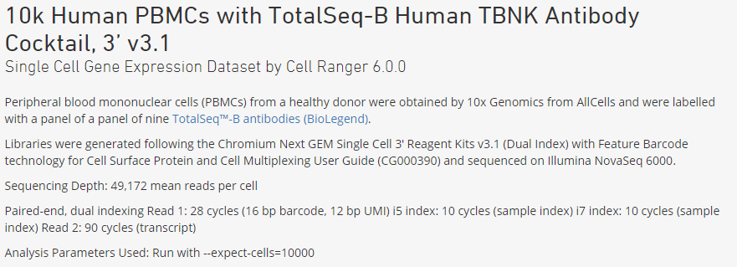
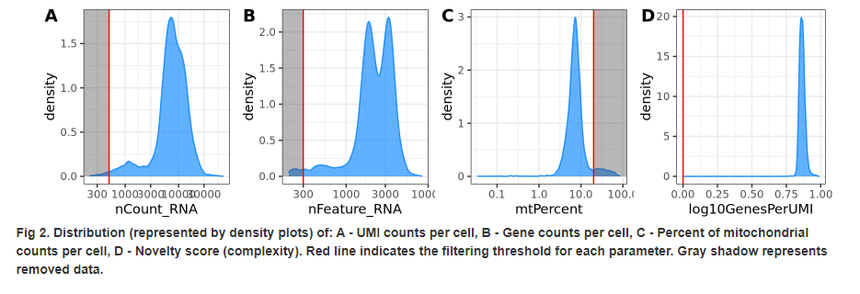
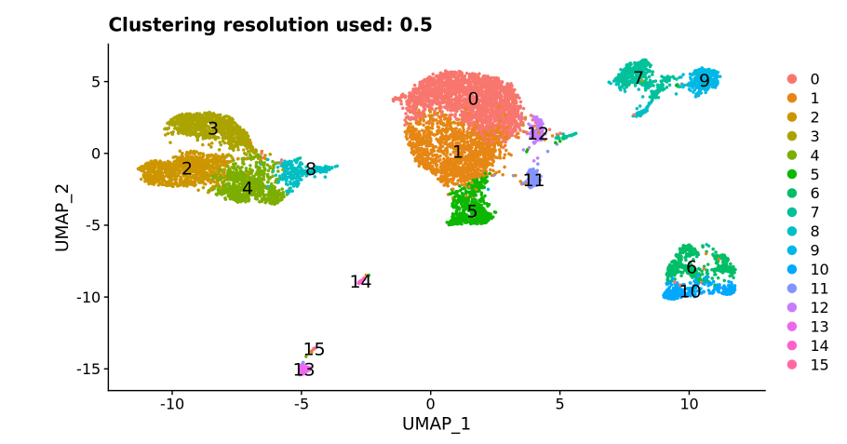
10k PMBC Results

Slide 4
Basic MIT and BGI Quality Control Measure compare to 10K PBMC
 | Estimated # of Cells | Mean Reads Per Cell | Median Genes per Cell | Sequencing Saturation | Reads Mapped to Intergenic Regions | Mapped to Transcriptome
10X | 9,247 | 49,311 | 2,277 | 59.70% | NA | NA
BGI
Control | 20,574 | 49,018 | 3,794 | 32.60% | 3.10% | 73.80%
Condition | 8,171 | 82,000 | 3,441 | 55.70% | 3.60% | 71.20%
MIT
Control | 16,218 | 76,790 | 1,914 | 56.10% | 8.40% | 52.40%
Condition | 4,495 | 298,187 | 1,178 | 87.40% | 15.40% | 43.50%

Slide 5
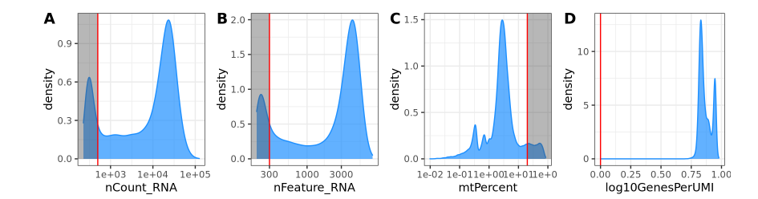
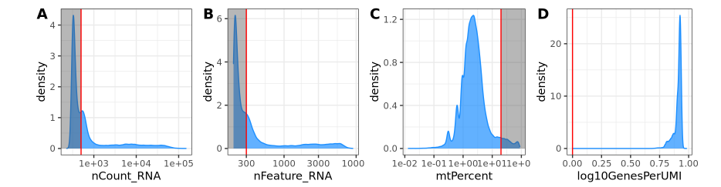
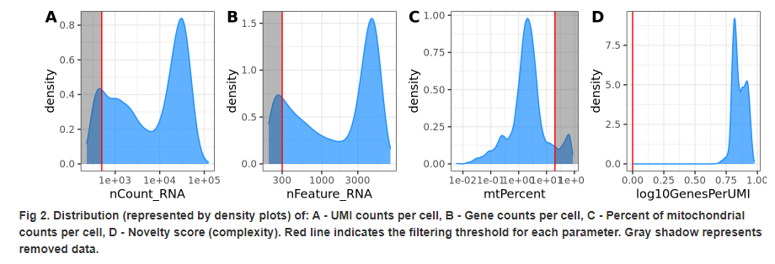
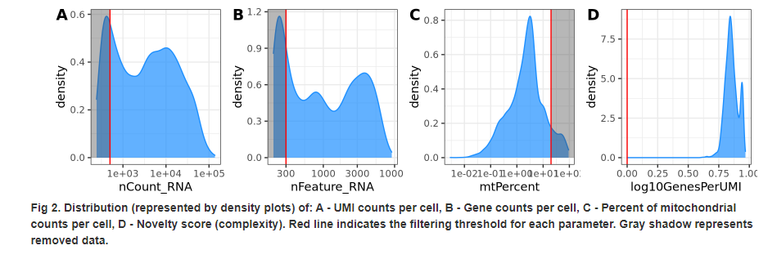
Distribution & Sampling Depth
10X
BGI
MIT
Control
Condition

Slide 6
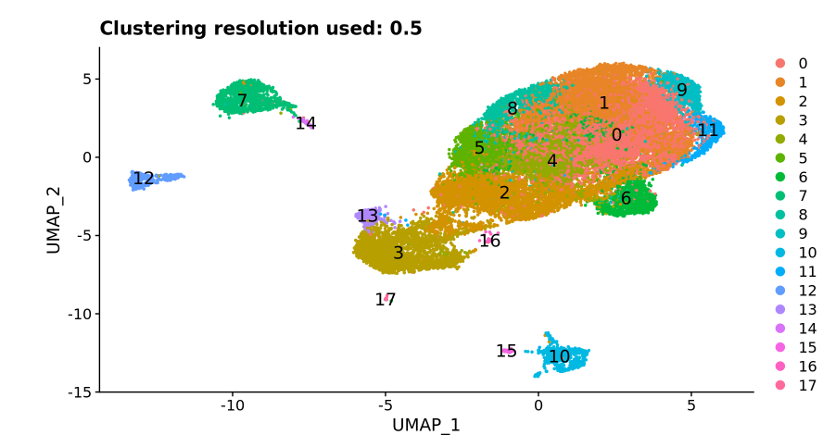
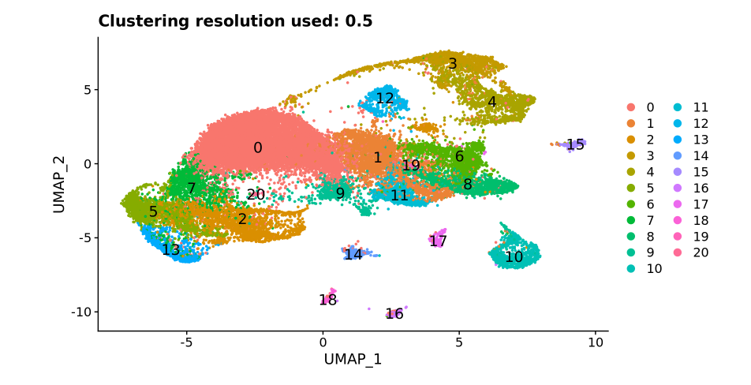
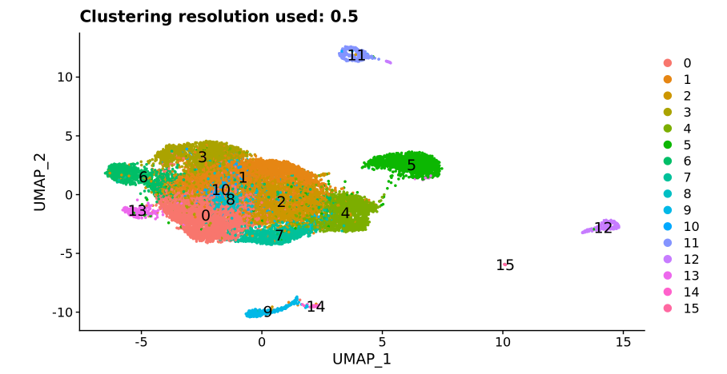
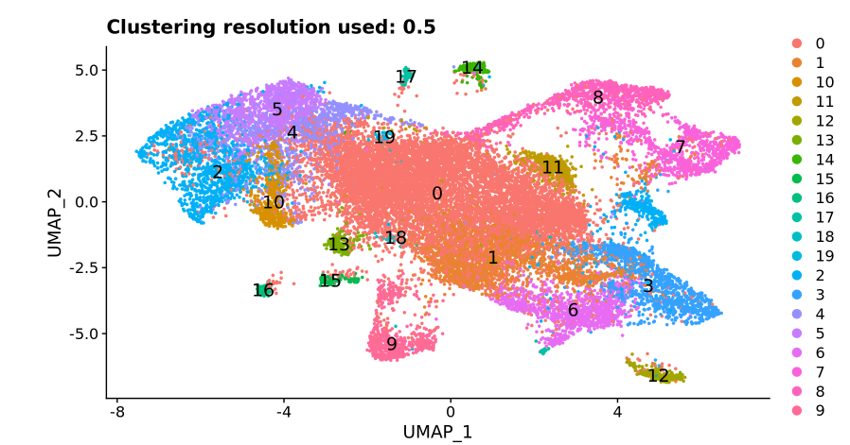
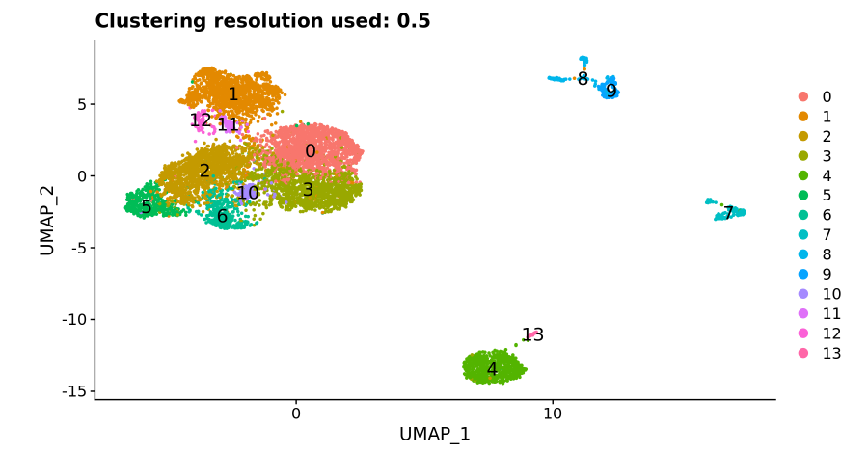
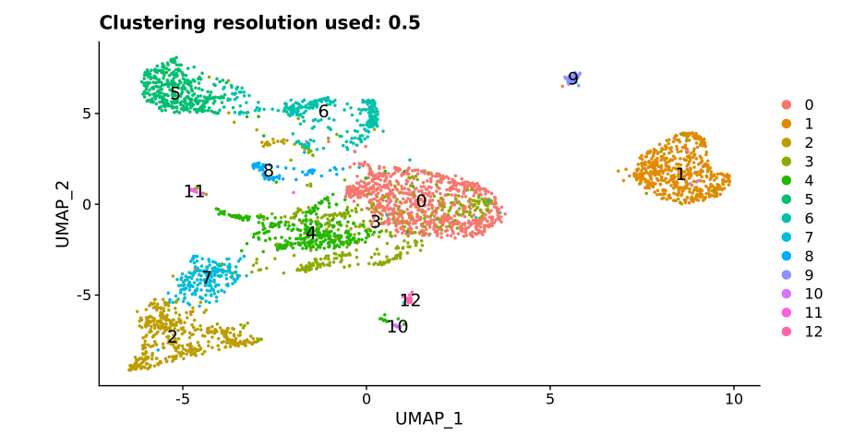
Overall Pattern
MIT
BGI
Complete
Control
Condition

Slide 7
Back up

Slide 8
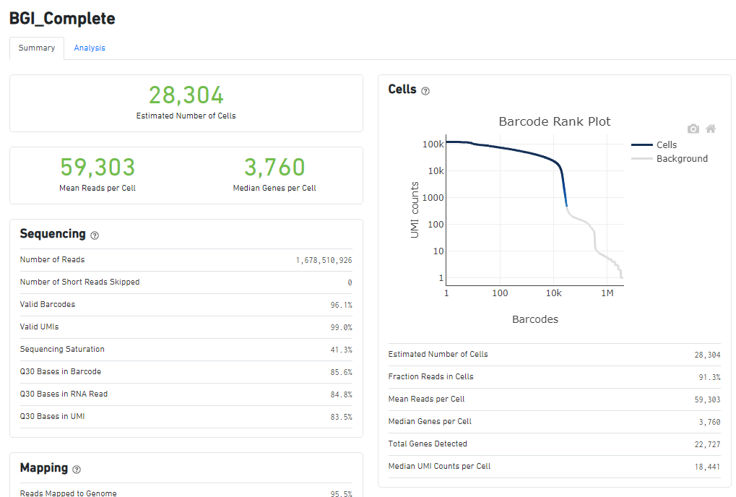
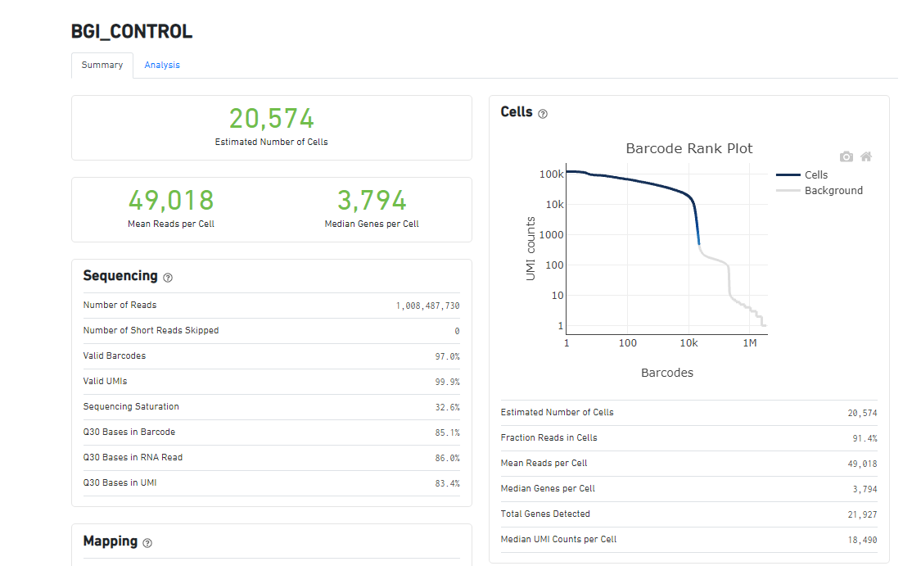
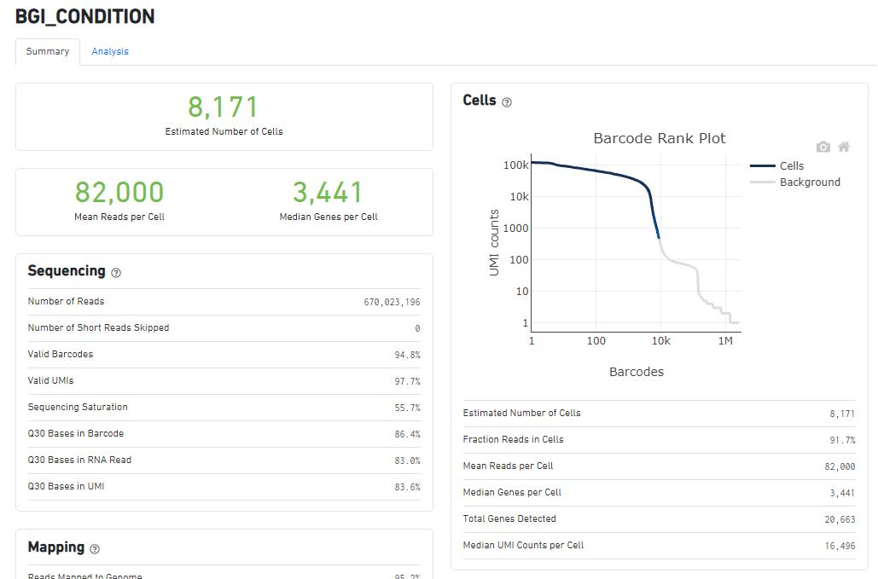
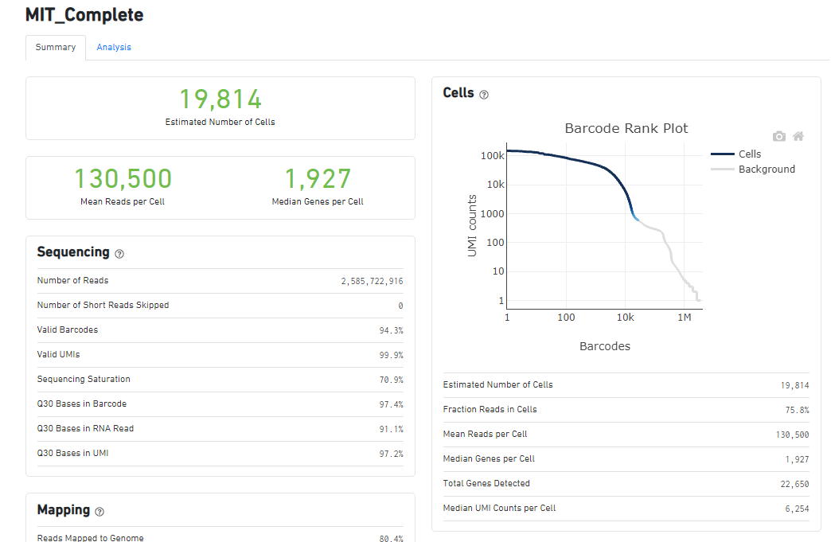
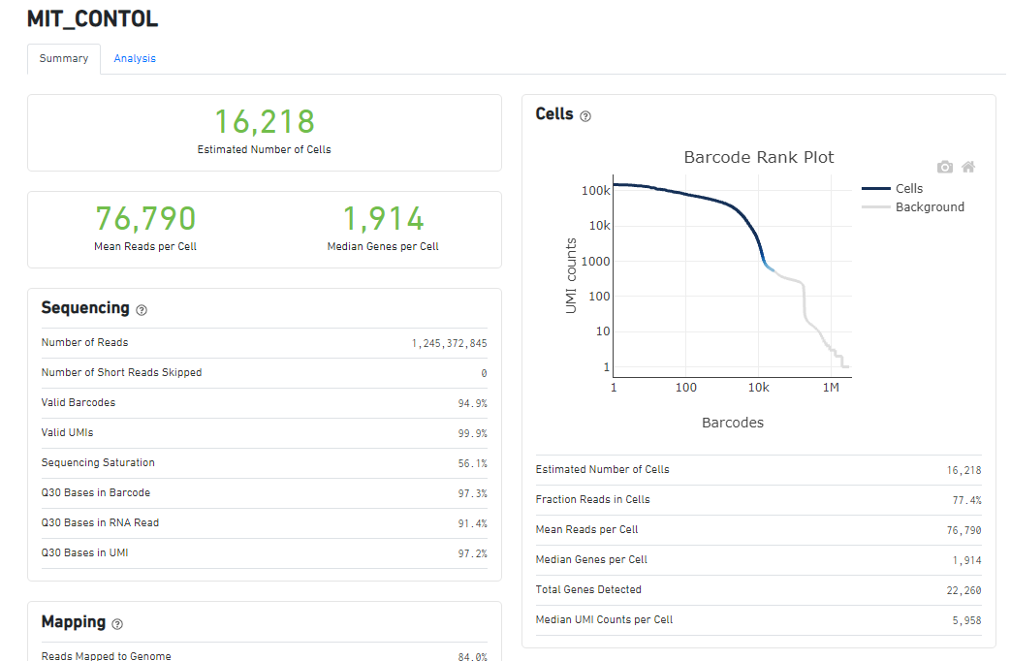
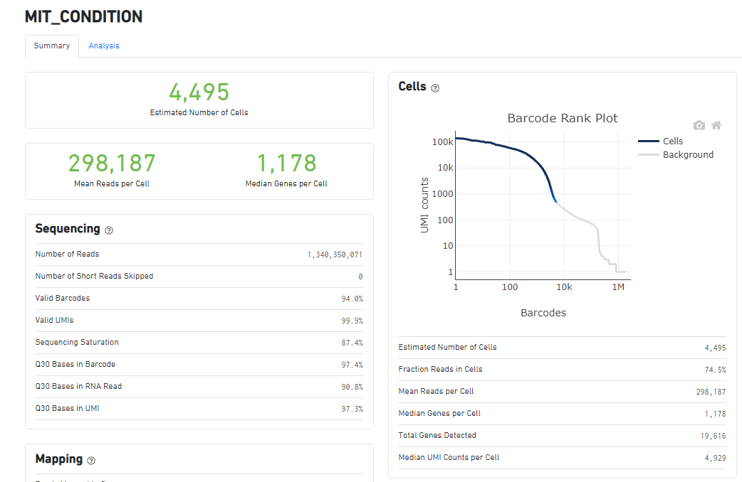
Overall Statistics

Slide 9
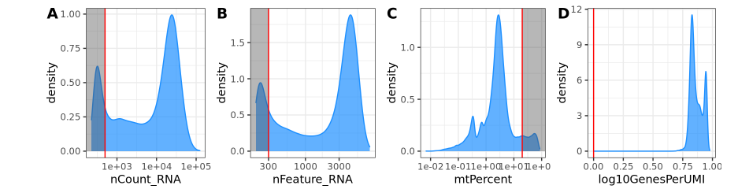
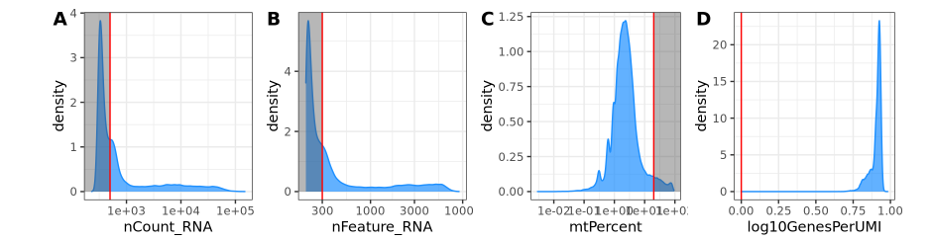
Distribution & Sampling Depth
BGI
MIT
Complete
Control
Condition

